Slide 2
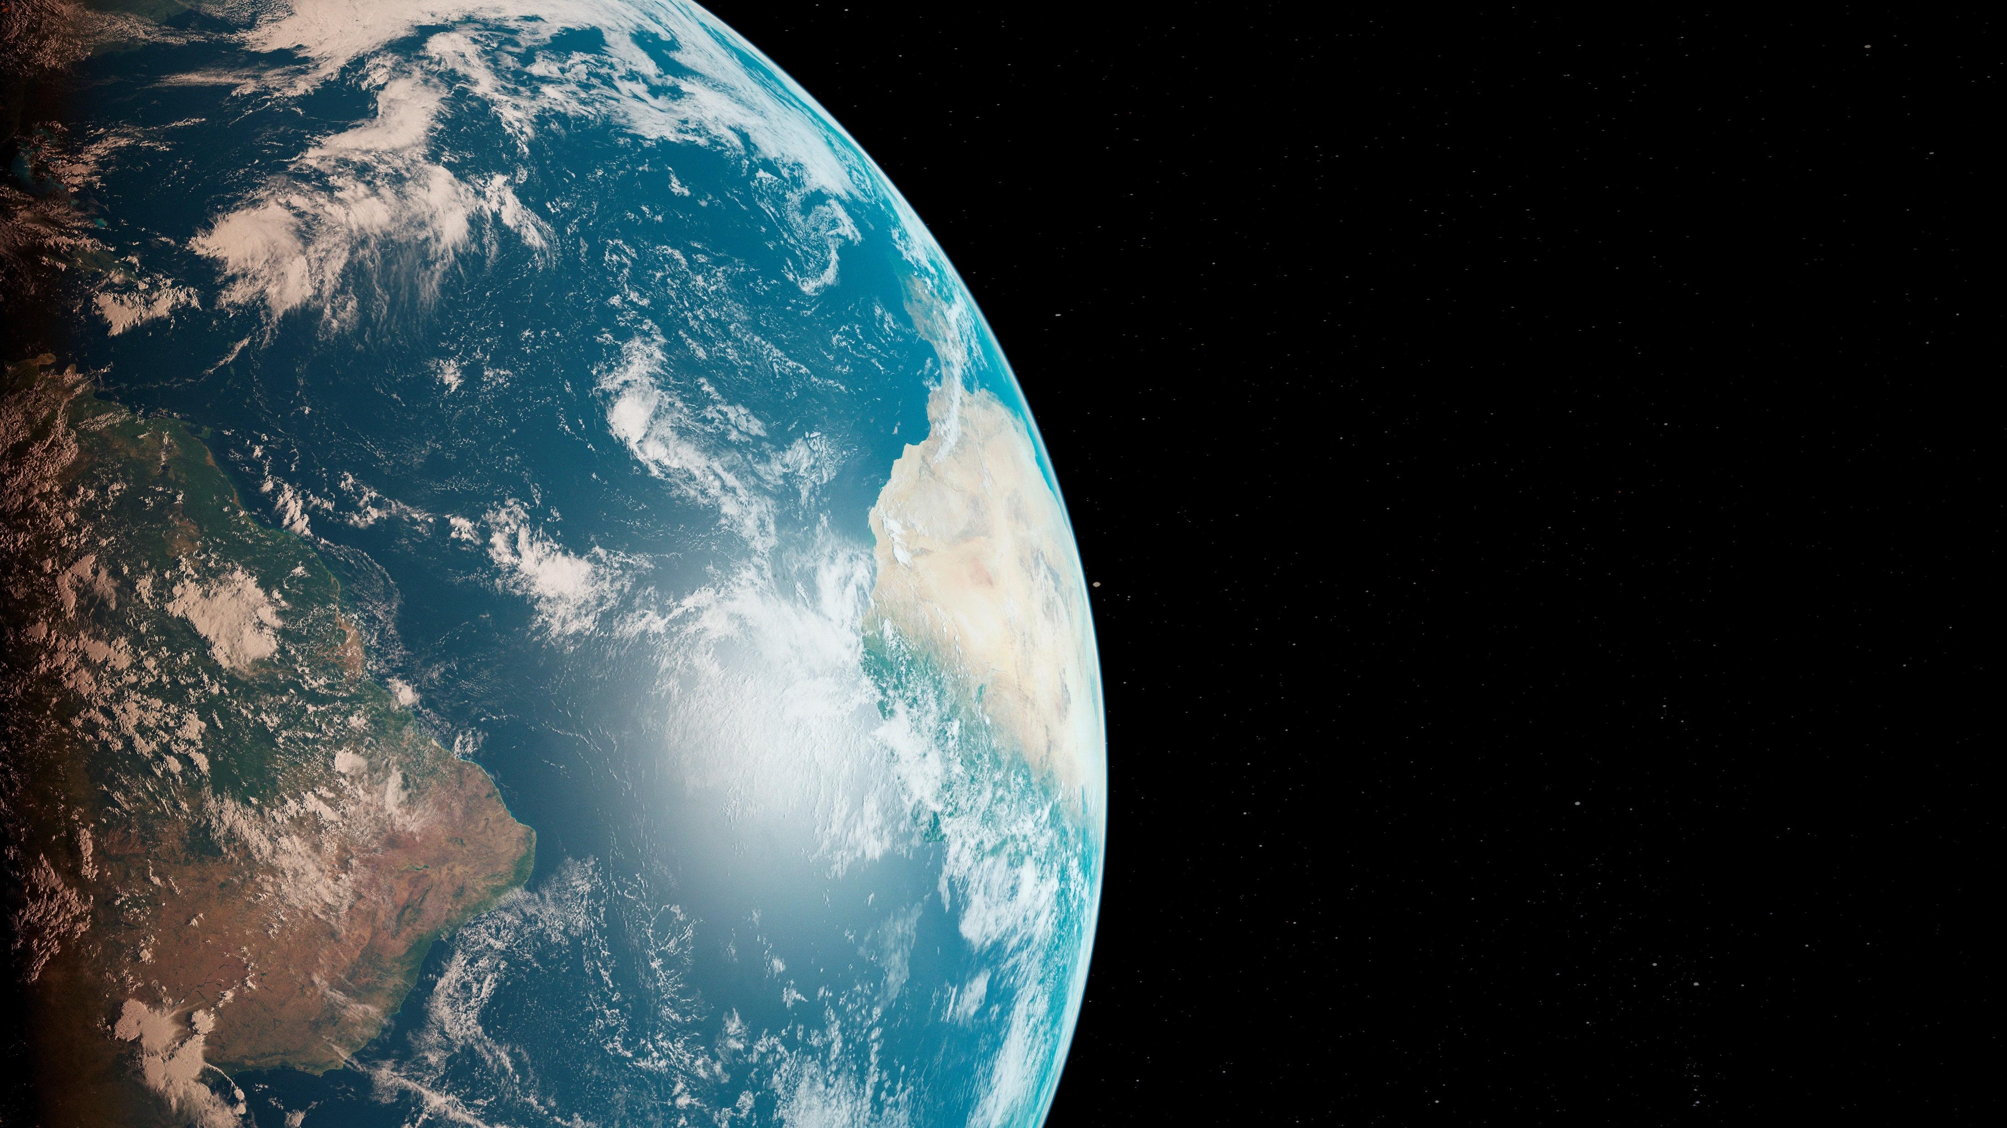
Where in the World??

Slide 3
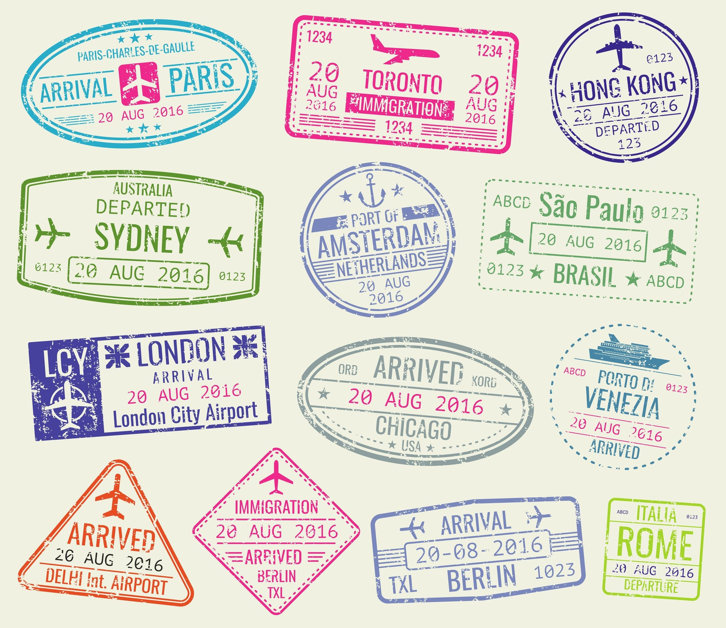
You’ve worked hard all year to design, create, operate, build, experience, research, share, live in, work in, inspire, and improve the built environment for seniors. Now, it’s time to sit back, relax, and have a little fun while SAGE whisks you around the globe, exploring lands near and far.
Let’s put a few more stamps in your passport as we share hints and clues about these vibrant locales. Click through the clues and work with your teammates to see if you can guess the location before its identity is revealed. You may even bump into some SAGE board members on your journey who will provide additional clues.
Have fun!

Slide 4
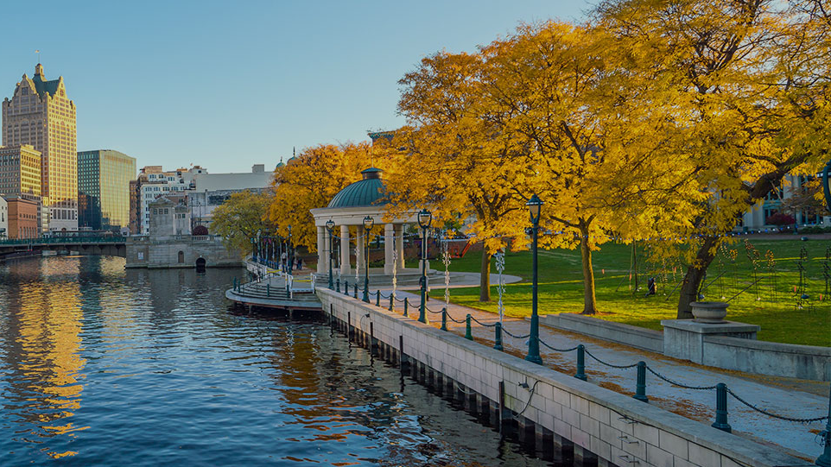
Location 1, Clue #1
It’s not hard to find a water view in this city!

Slide 5
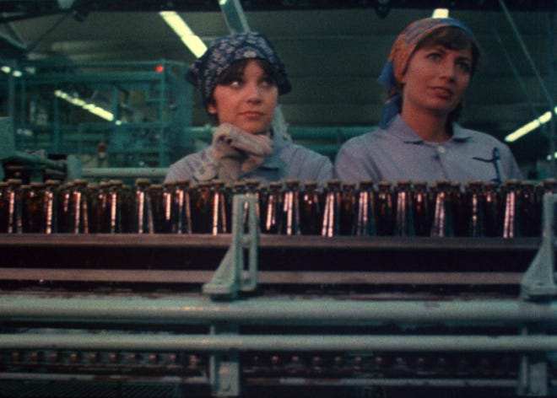
Clue #2
1 2 3 4 5 6 7 8 Schlemiel! Schlimazel! Hasenpfeffer Incorporated!

Slide 6
Clues #3, 4, and 5

Slide 7
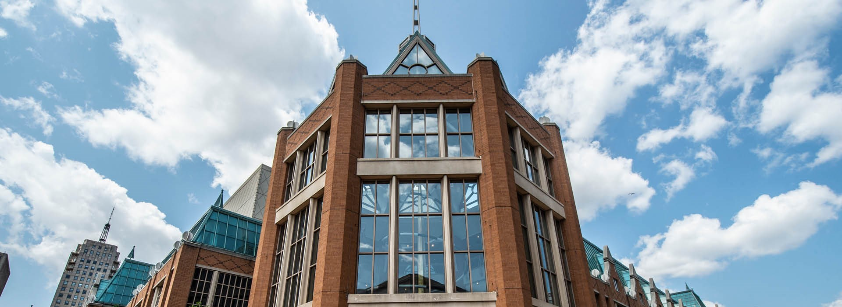
Final Clue!
↓ We hope to see many of YOU in this building next April! ↓

Slide 8
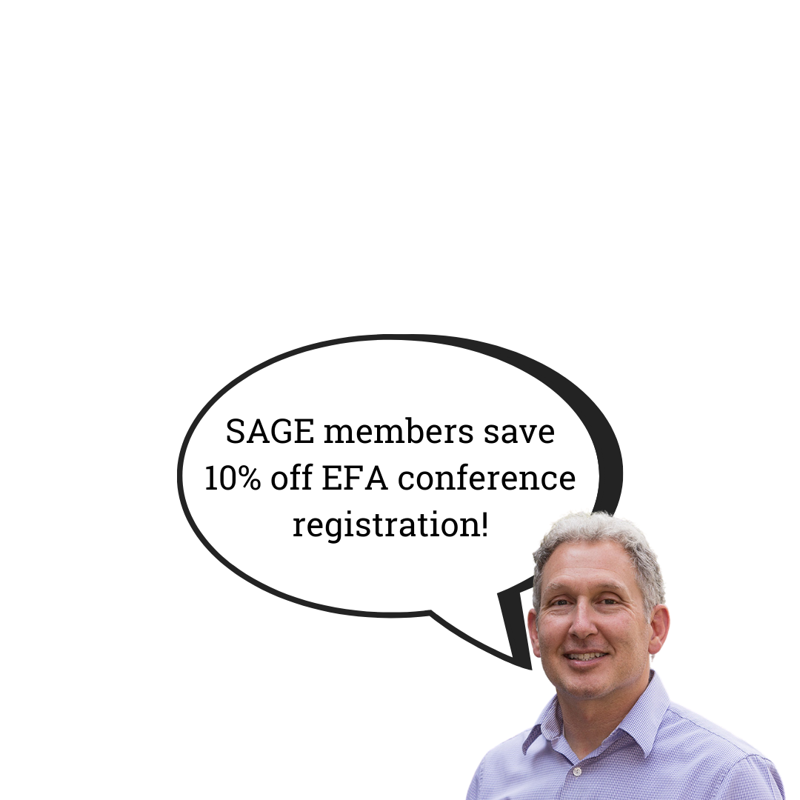
You’ve just visited:

Slide 9
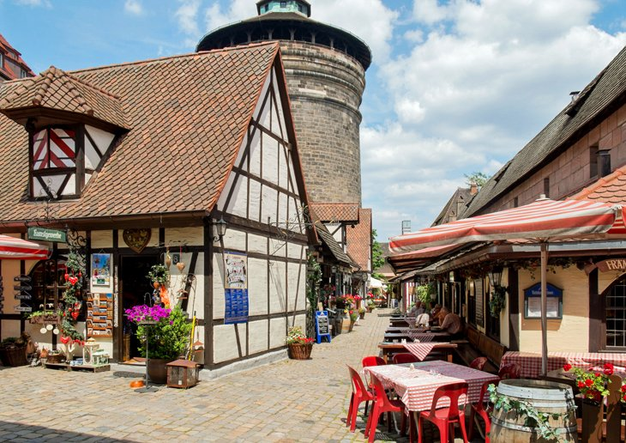
Location 2,
Clue #1
This city is the second-largest in the country.

Slide 10
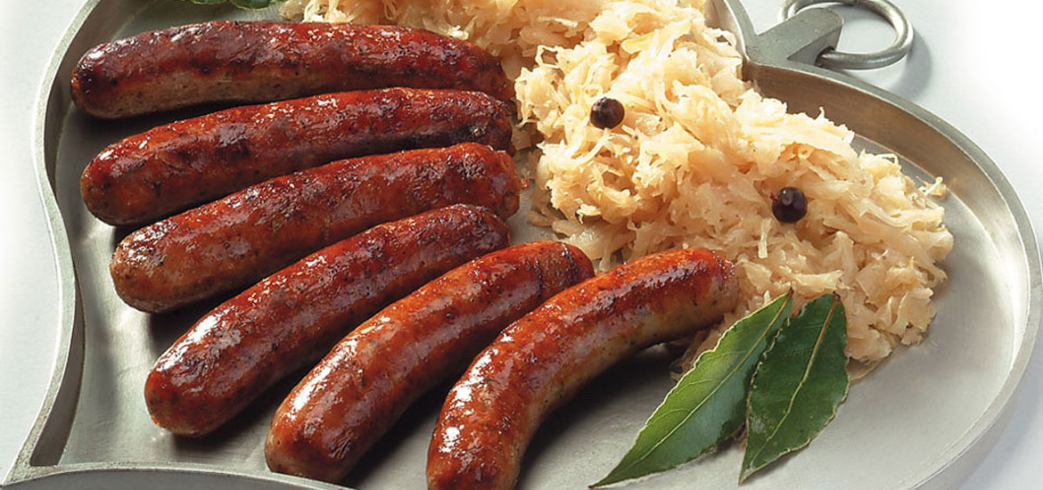
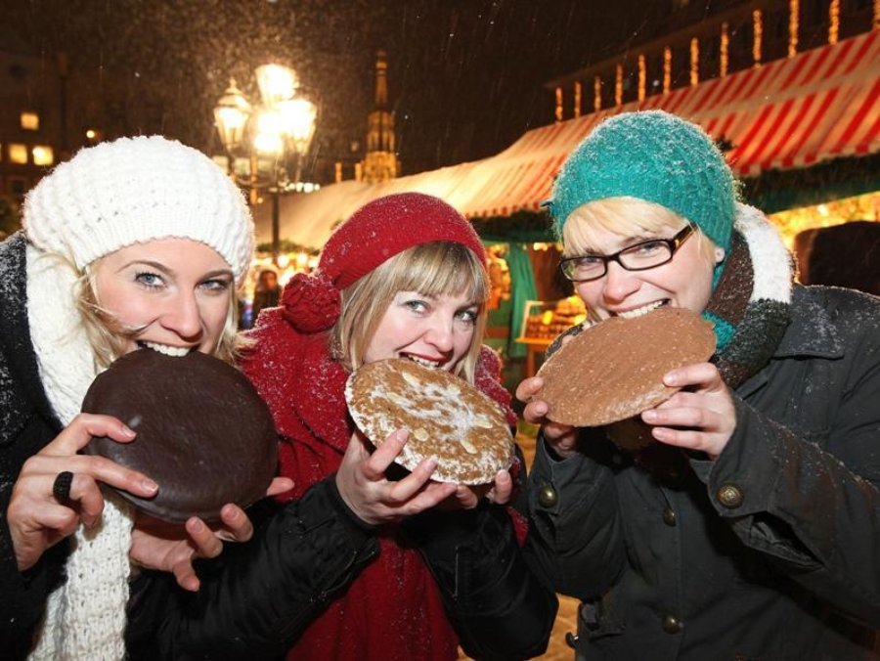
Clues #2 and 3
Just like Milwaukee, this city is known for ↓
BRATS
but also for…
GINGERBREAD

Slide 11
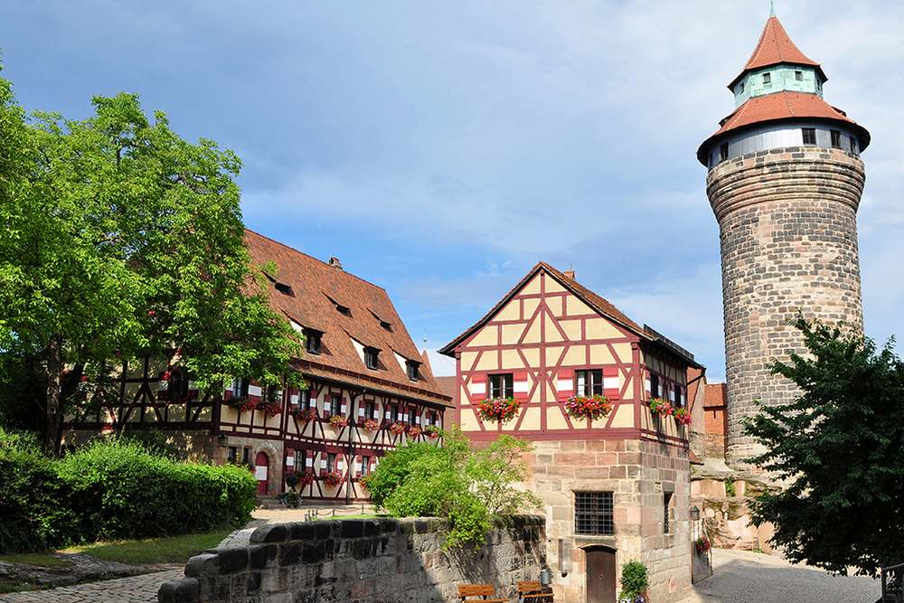
Clue #4
From 1050 to 1571, this castle was the home to all its country’s kings and emperors. Today the 351-metre tall structure dominates the skyline as a symbol of the city.
Bonus Clue:
The country no longer has a monarch.

Slide 12
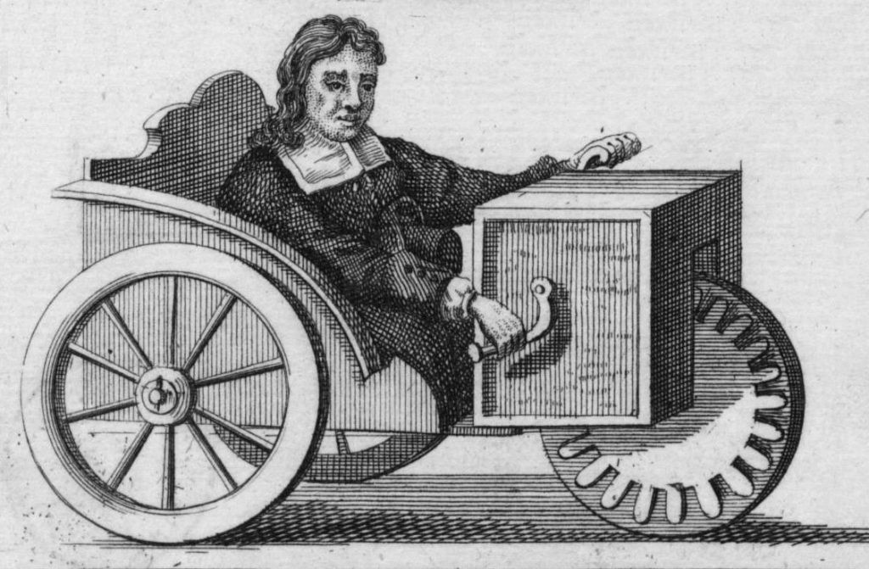
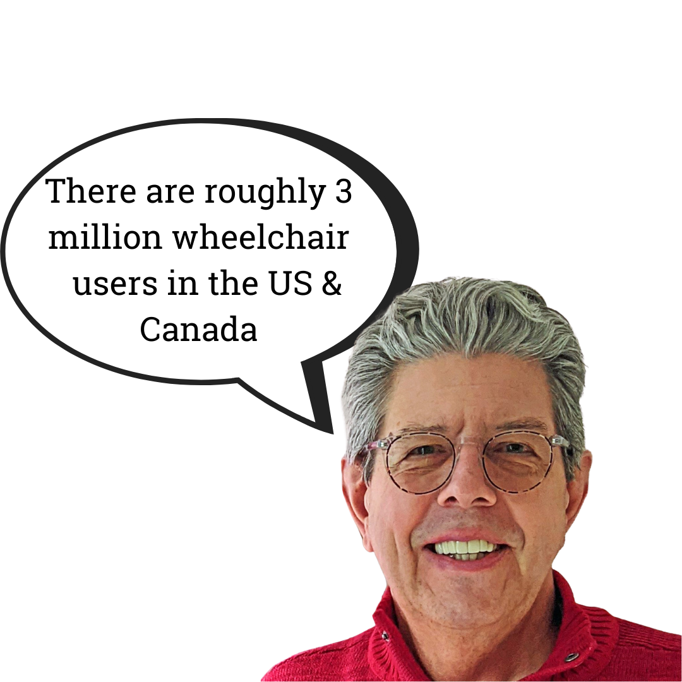
Final Clue!
The first self-propelled wheelchair was invented in 1655 in this city, by a paraplegic clock-maker who built his own mobility aid when he was only 22 after having broken his back as a child.

Slide 13
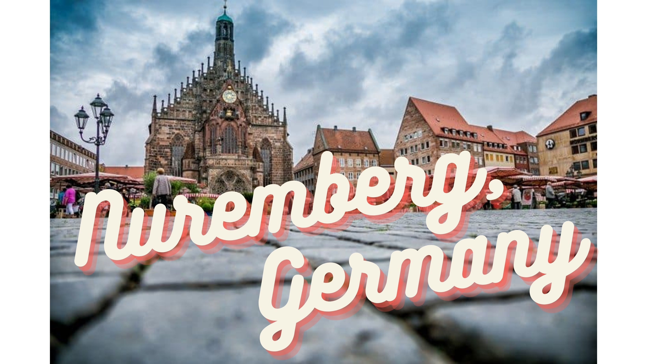
You’ve just visited:

Slide 14
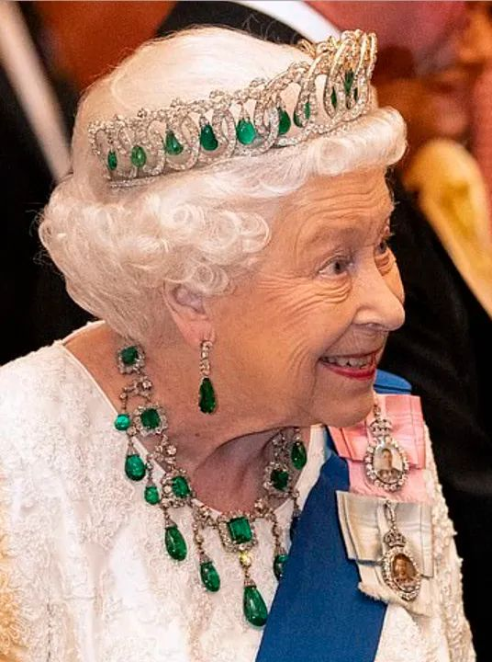
Location 3, Clue #1
For 113 years, this city was nicknamed the “Queen City.” That all changed in 1982 when the city adopted an epithet using the name of the green sparklers on the queen’s tiara and necklace.

Slide 15
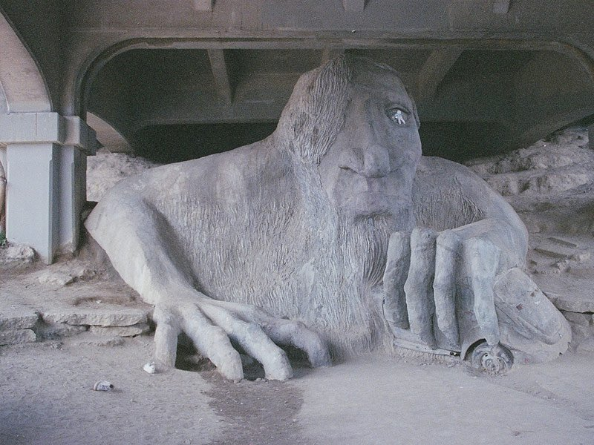
Clue #2
The 18-foot-tall, one-eyed troll lives under a bridge in this city and sits clutching a Volkswagen Bug. Created in 1990, the two-ton sculpture is made of concrete, wire and steel, with a hubcap serving as his one good eye.

Slide 16
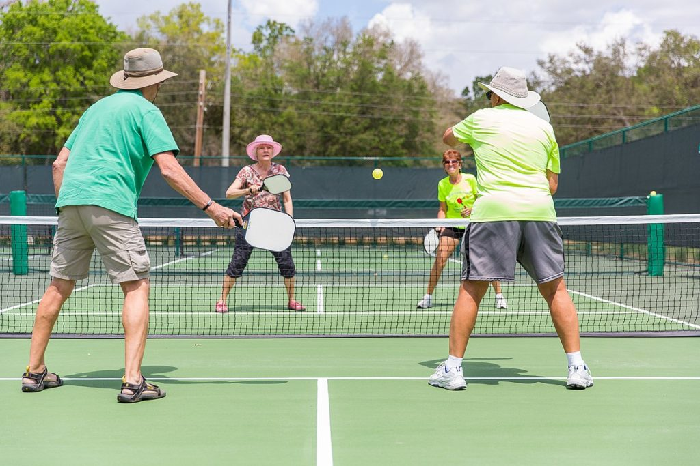
Clue #3
Pickleball Mania is sweeping the senior-living world! More and more seniors are picking up a paddle and hitting the courts for this fun, low-impact activity. And they can thank a resident of an island visible from this city for inventing the sport in 1965.

Slide 17
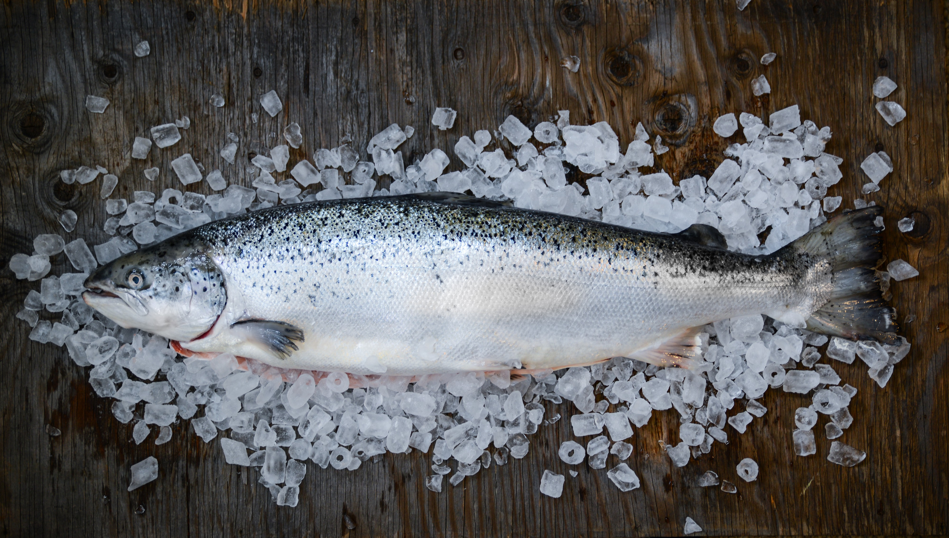
Clue #4
Something’s fishy…
The fish fly off the shelves in this city,
known for its sensational seafood!

Slide 18
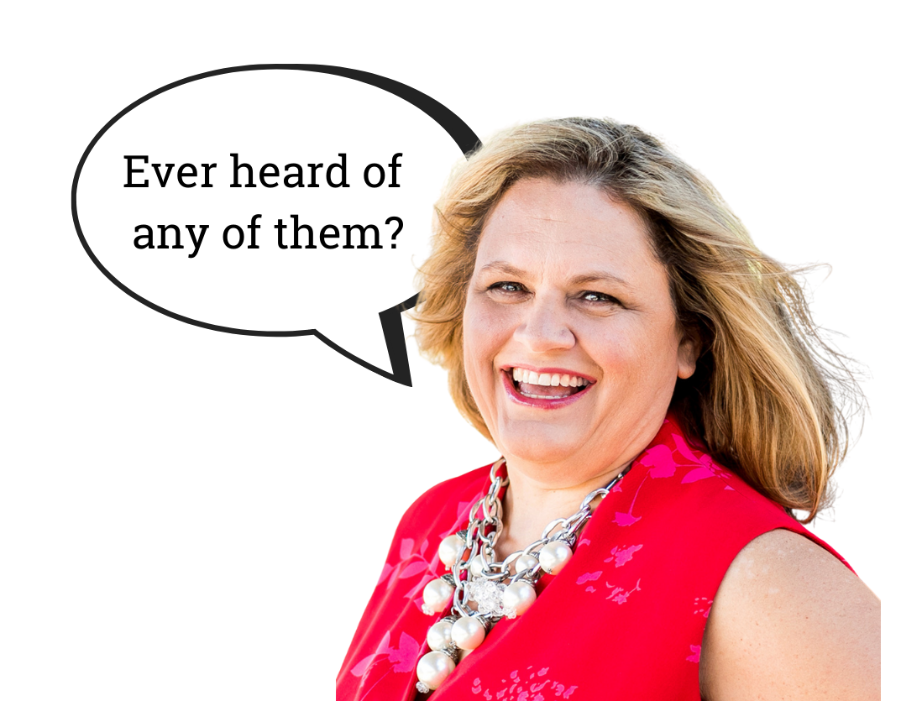
Final Clue!
Chances are, you support the economy of this city and surrounding areas every day if you use or purchase products from any of these companies, which are among the top 10 employers in the area:

Slide 19
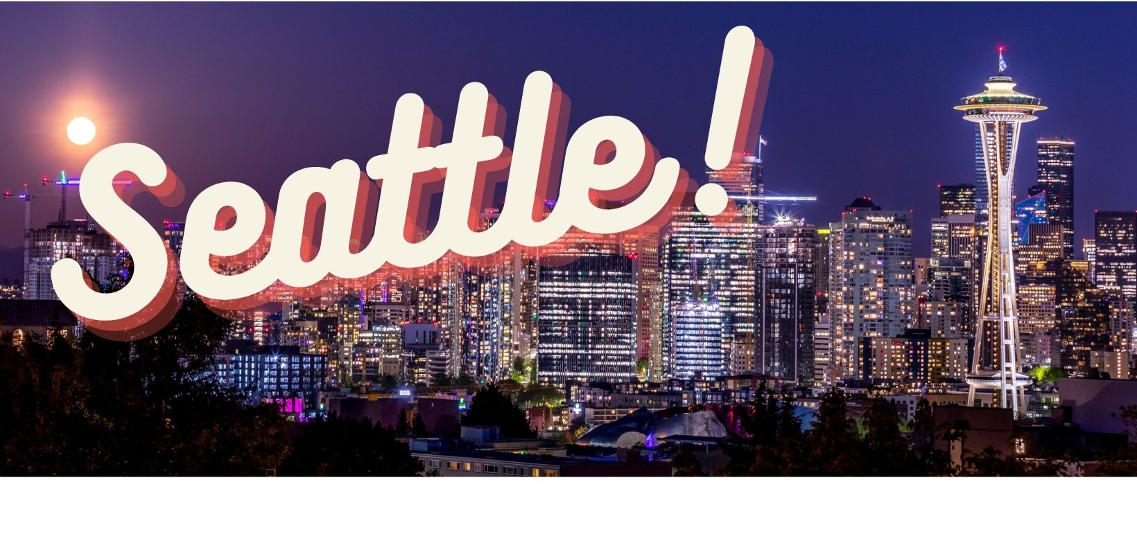
You’ve just visited:

Slide 20
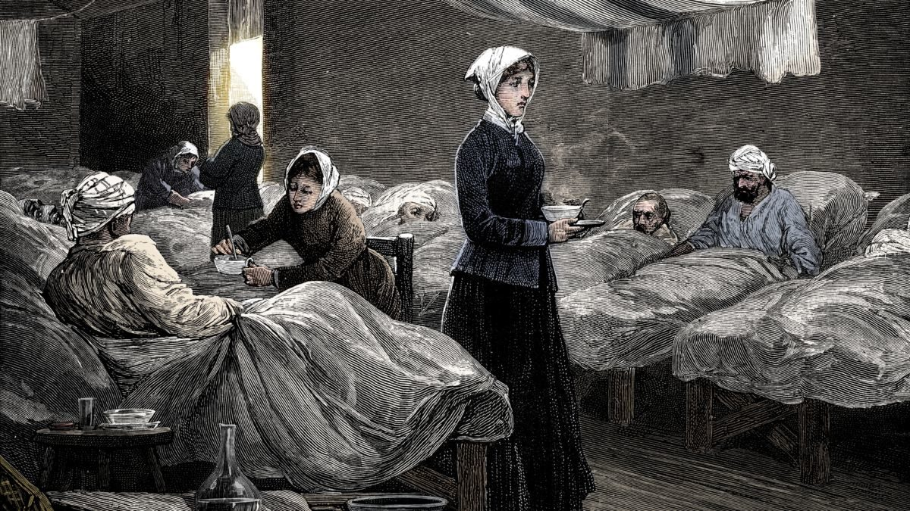
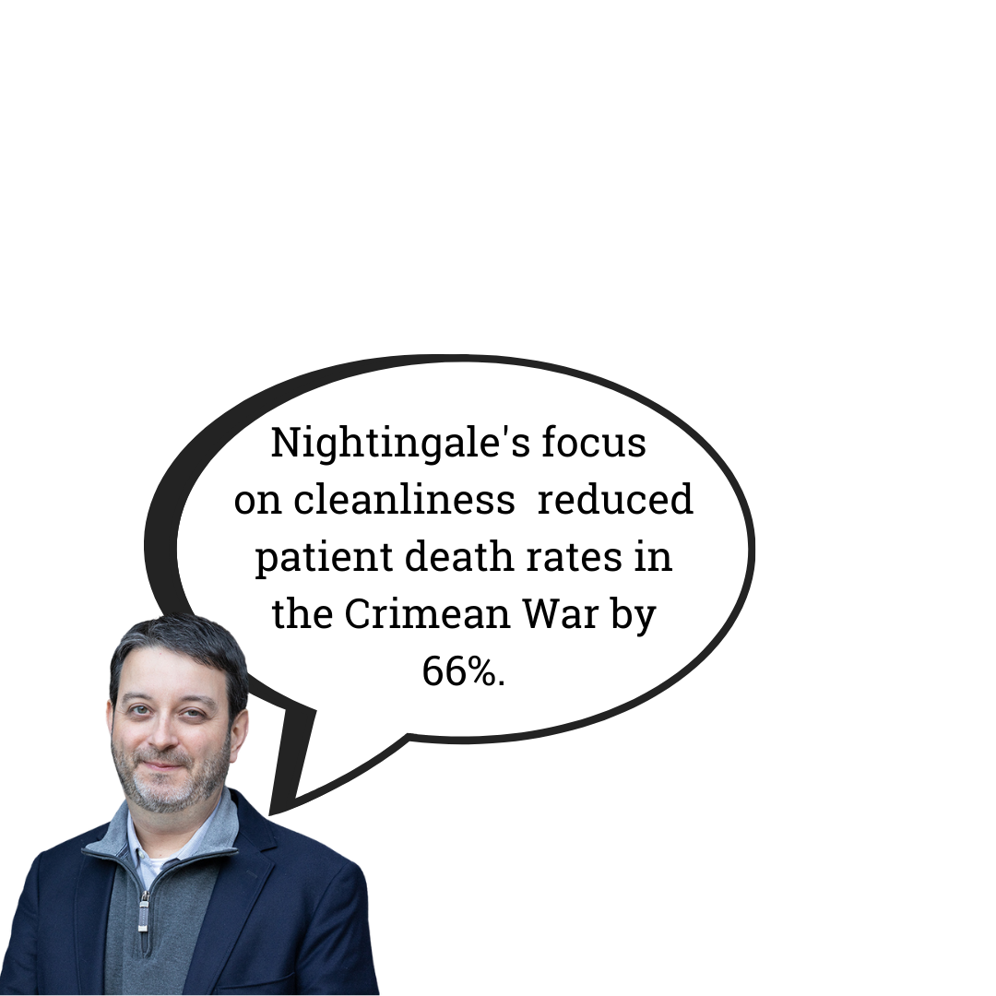
Location 4, Clue #1
Florence Nightingale, the inventor of the nurse call system, was born in this city.

Slide 21
Clue #2
The streets may look dry in this photo, but the city has had two floods; one on November 4, 1333, and one on November 4, 1966 – exactly 633 years apart!

Slide 22
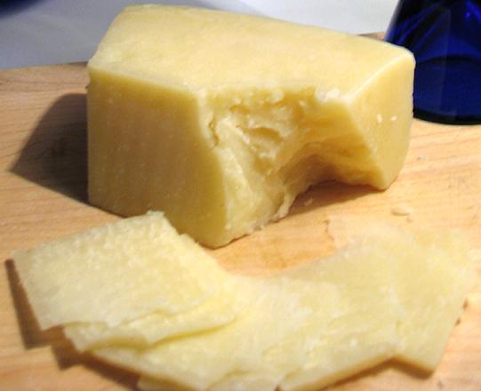
Clue #3
The most popular cheese in the area is Pecorino, a hard cheese made from whole sheep's milk between September and June when the grass is best for grazing.

Slide 23
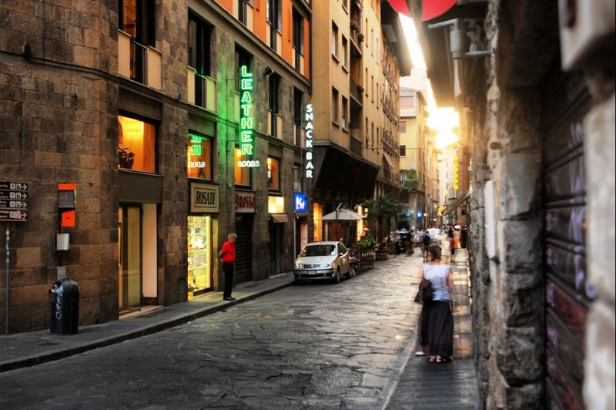
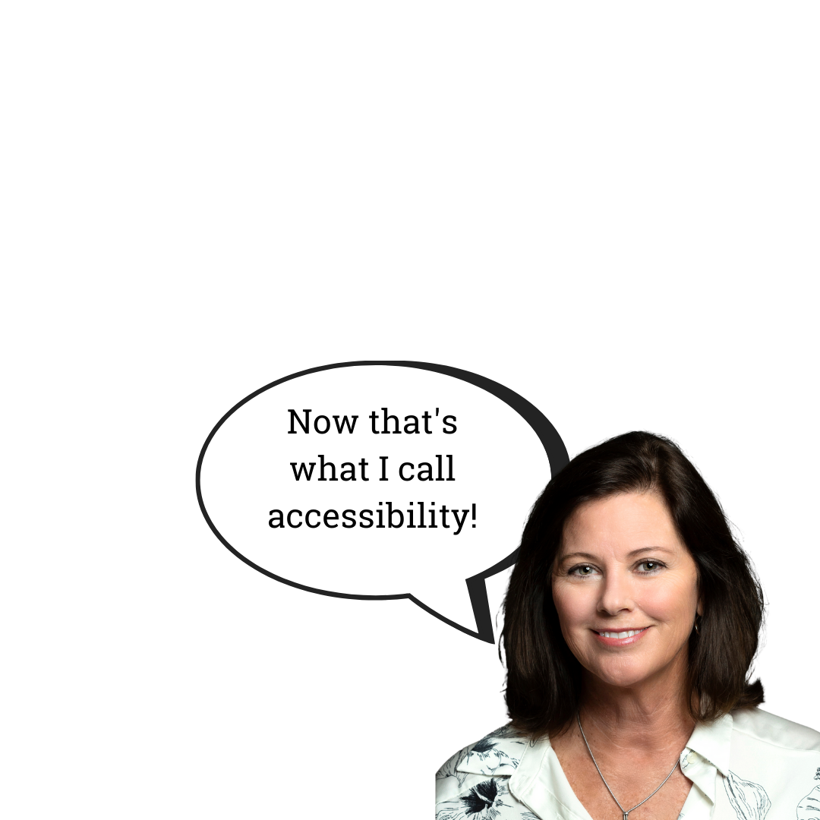
Clue #4
In 1339, this city was the first on the continent to pave all its streets and roads!

Slide 24
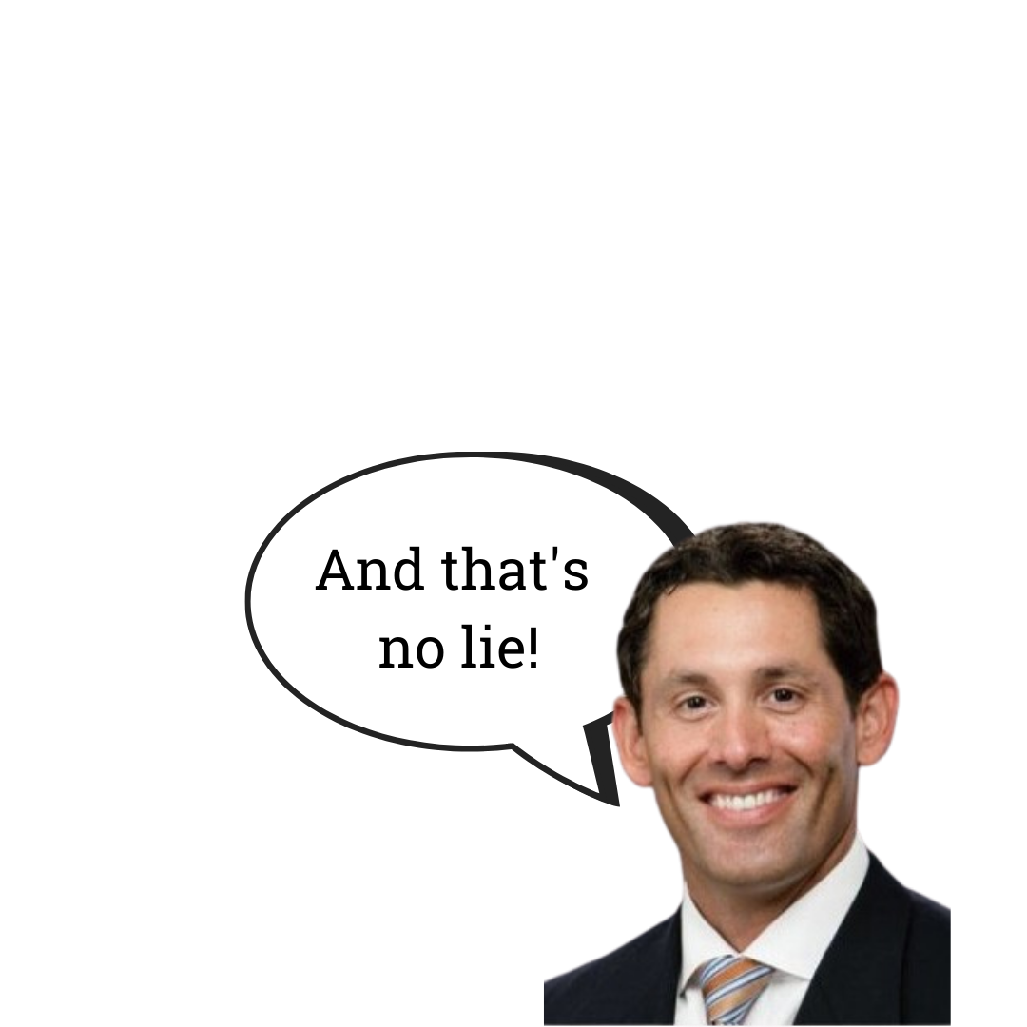
Final Clue!
The author of Pinocchio is from this city

Slide 25
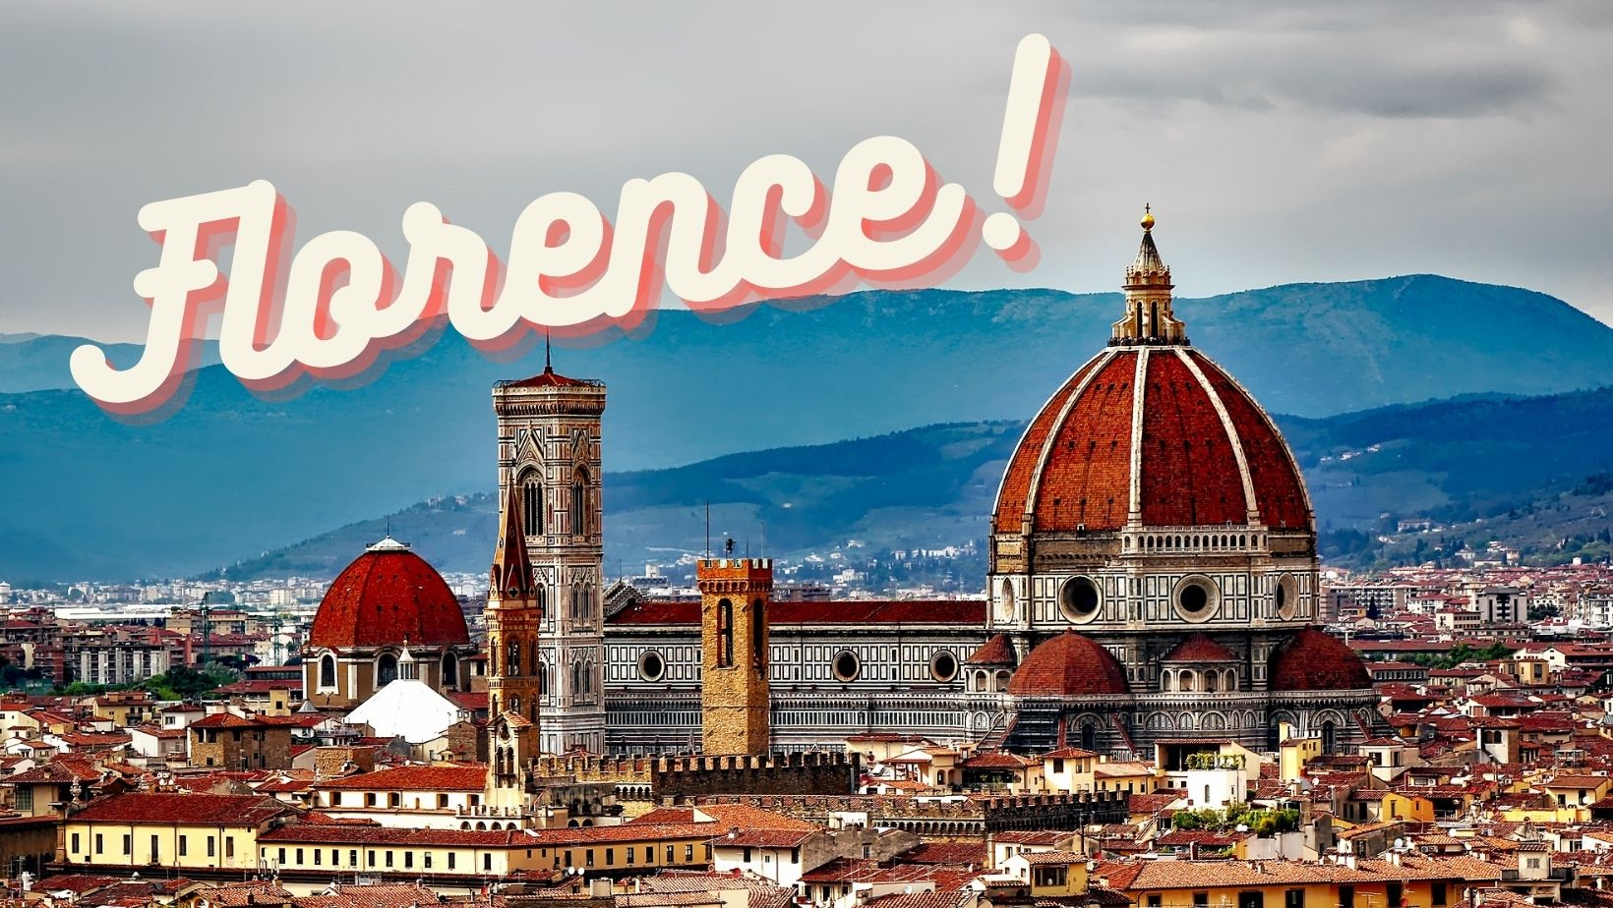
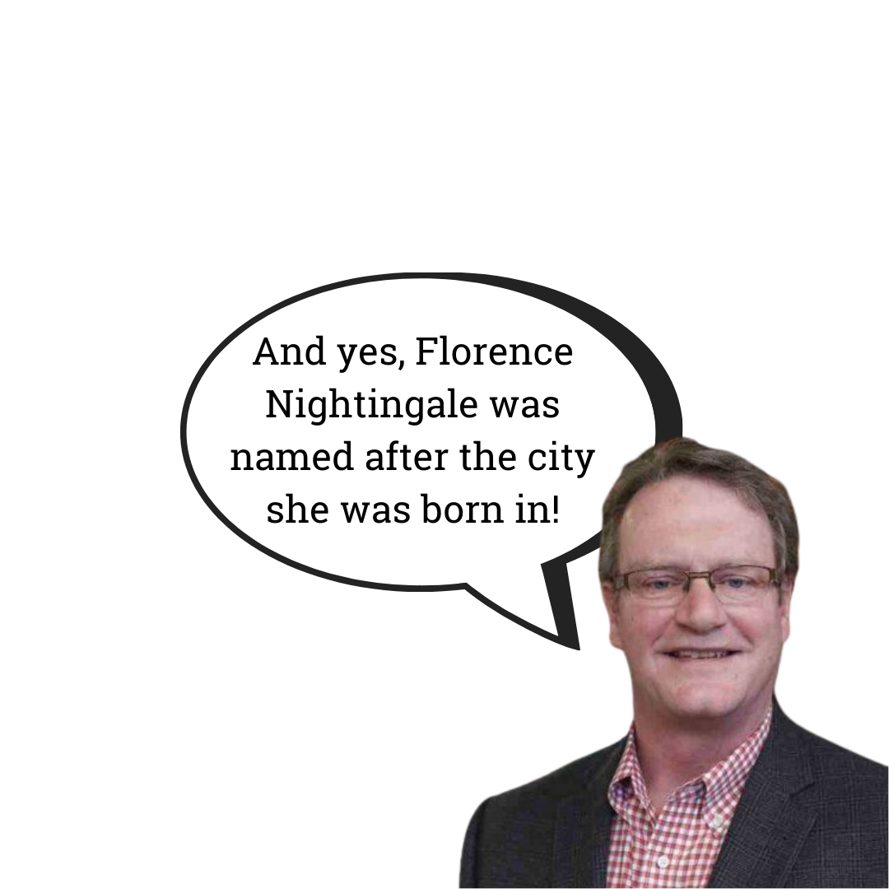
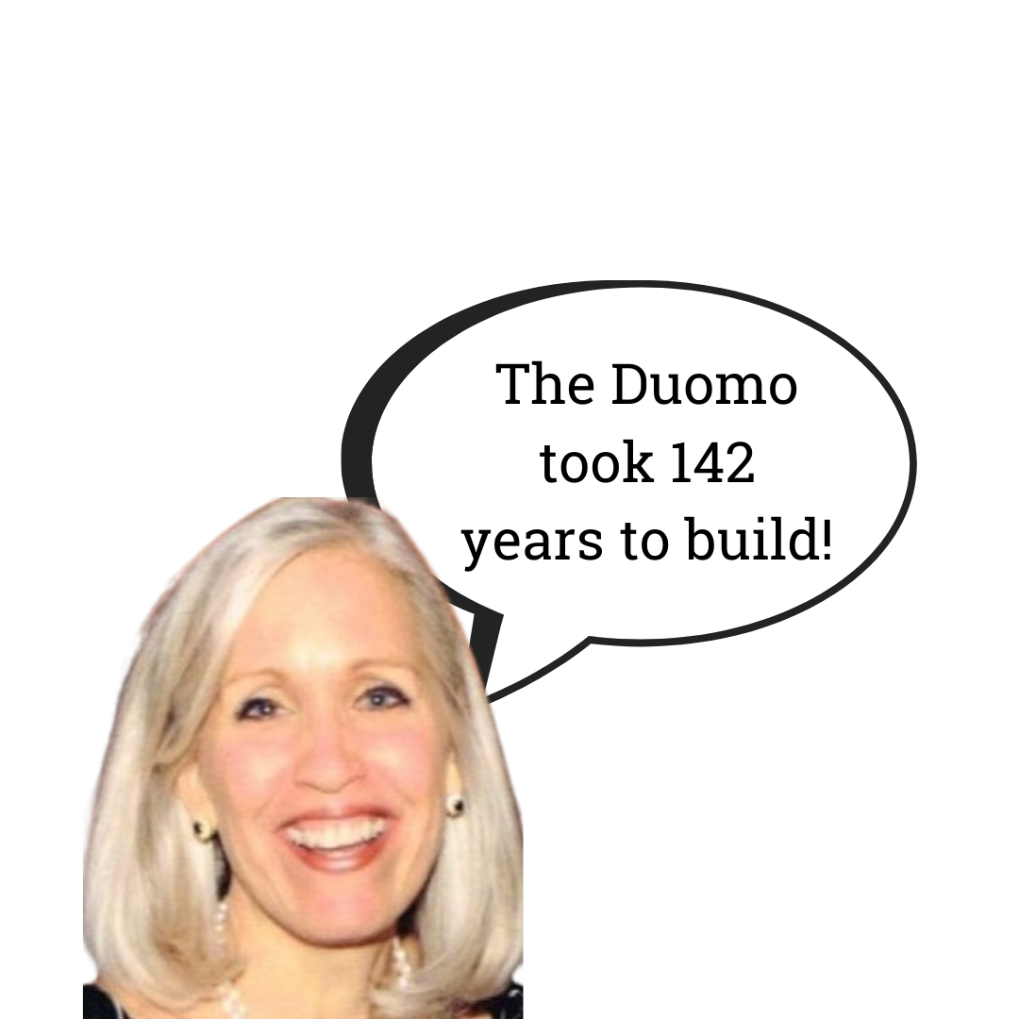
You’ve just visited:

Slide 26
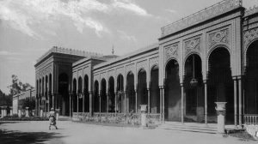
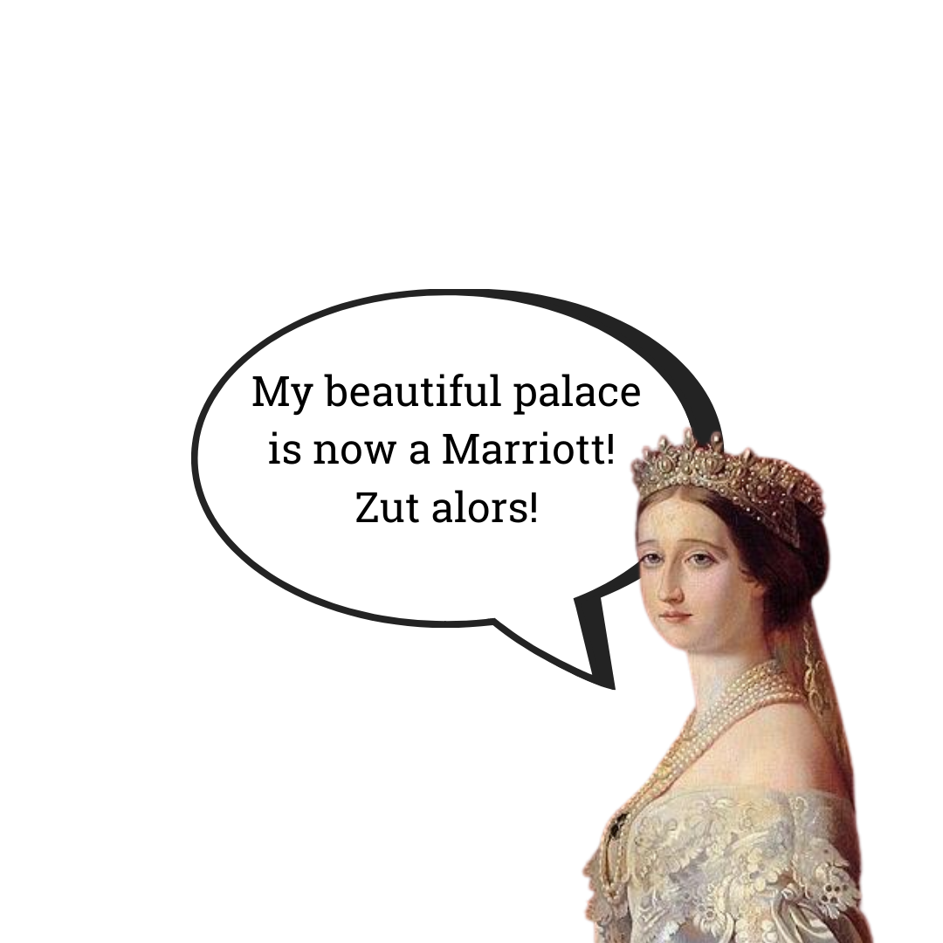
Location 5, Clue #1
This palace was built for Empress
Eugenie, wife of Napolean III.

Slide 27
Clue #2
This city has two islands within city limits!

Slide 28
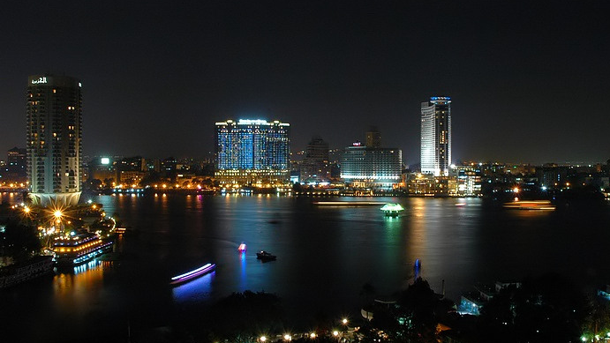
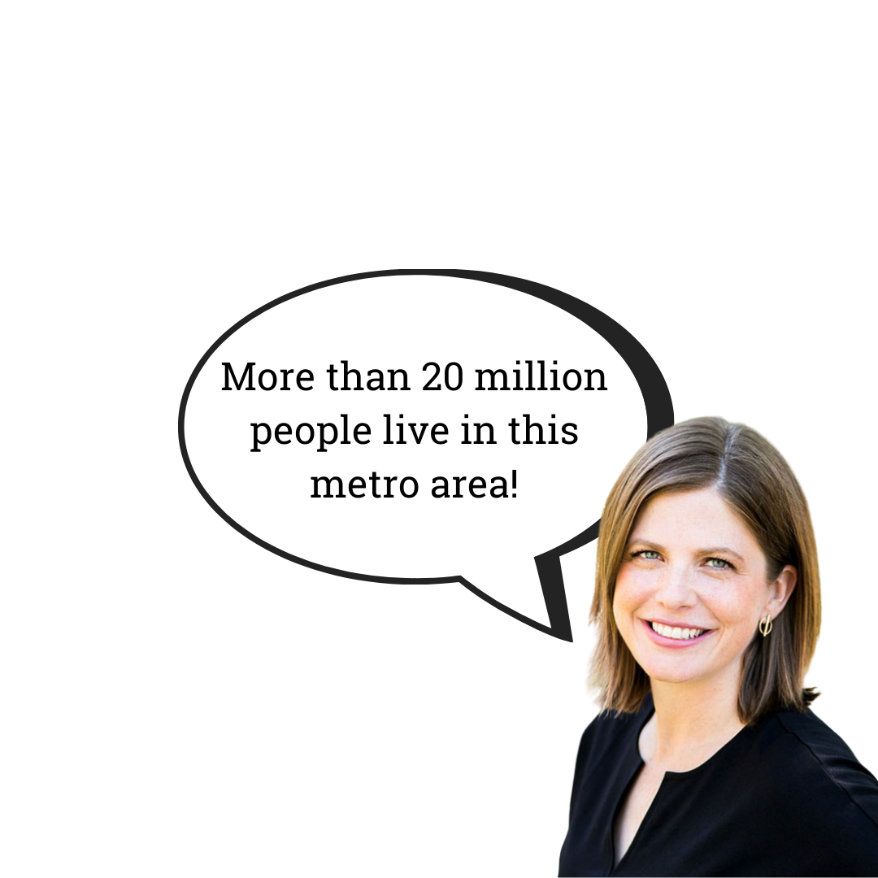
Clue #3

Slide 29
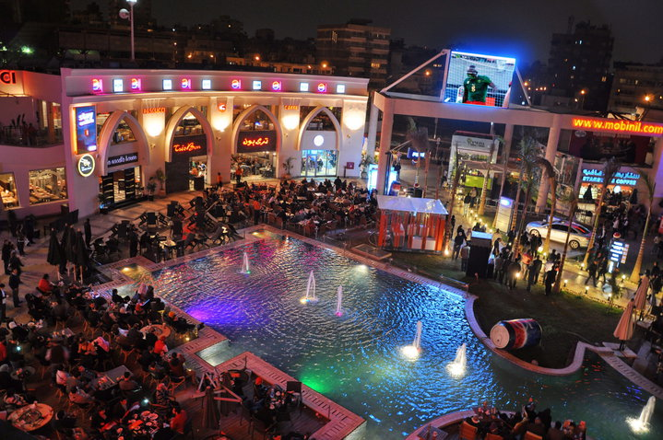
Clue #4
This city hosts the world’s largest food court!
The giant eatery features 25 cafes and restaurants and space for more than 4,000 diners.

Slide 30
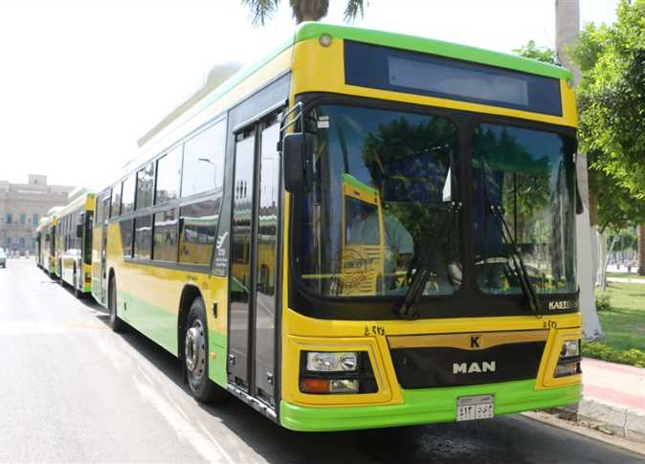
Final Clue!
Those over 70 years of age enjoy free public transportation – including railway, buses, and metro - not just in this city, but throughout the entire country!

Slide 31
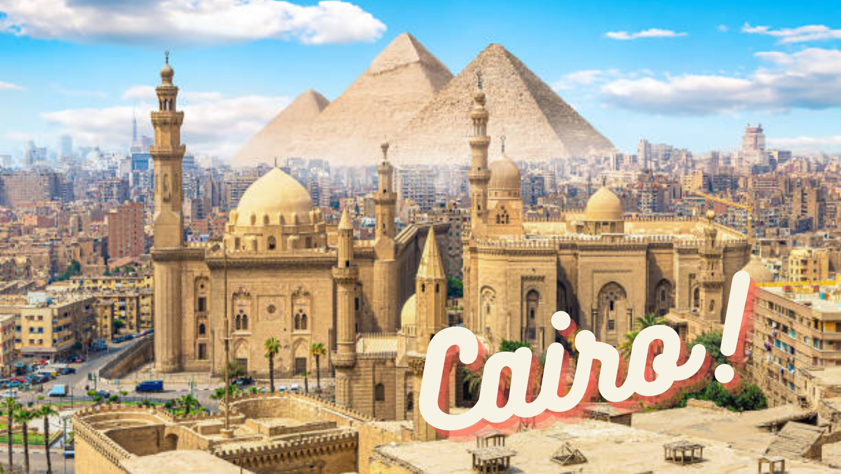
You’ve just visited:

Slide 32
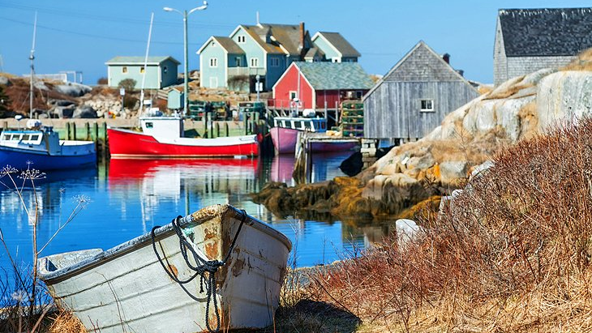
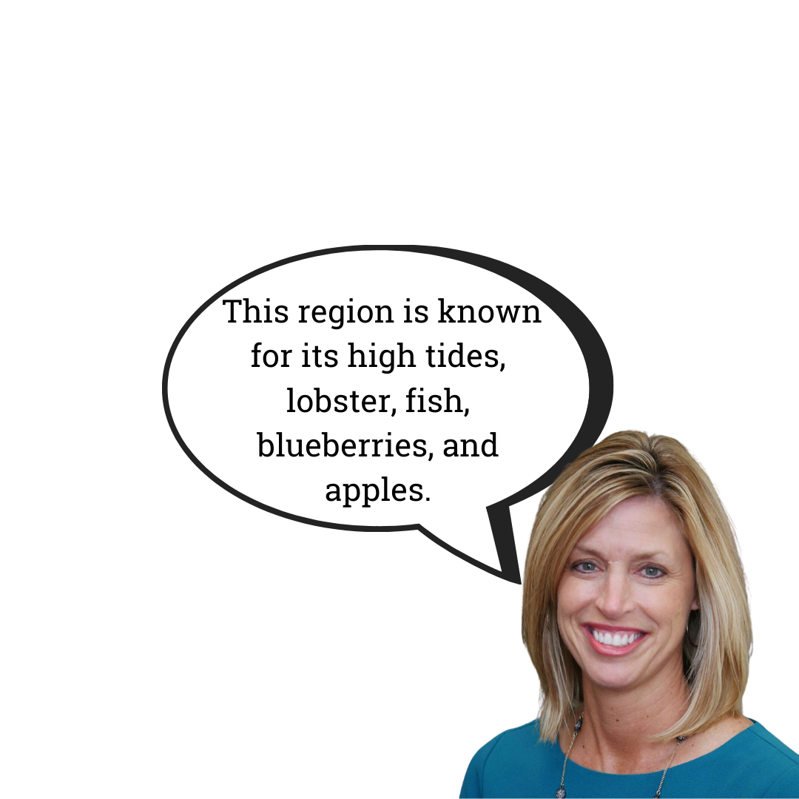
Location 6, Clue #1

Slide 33
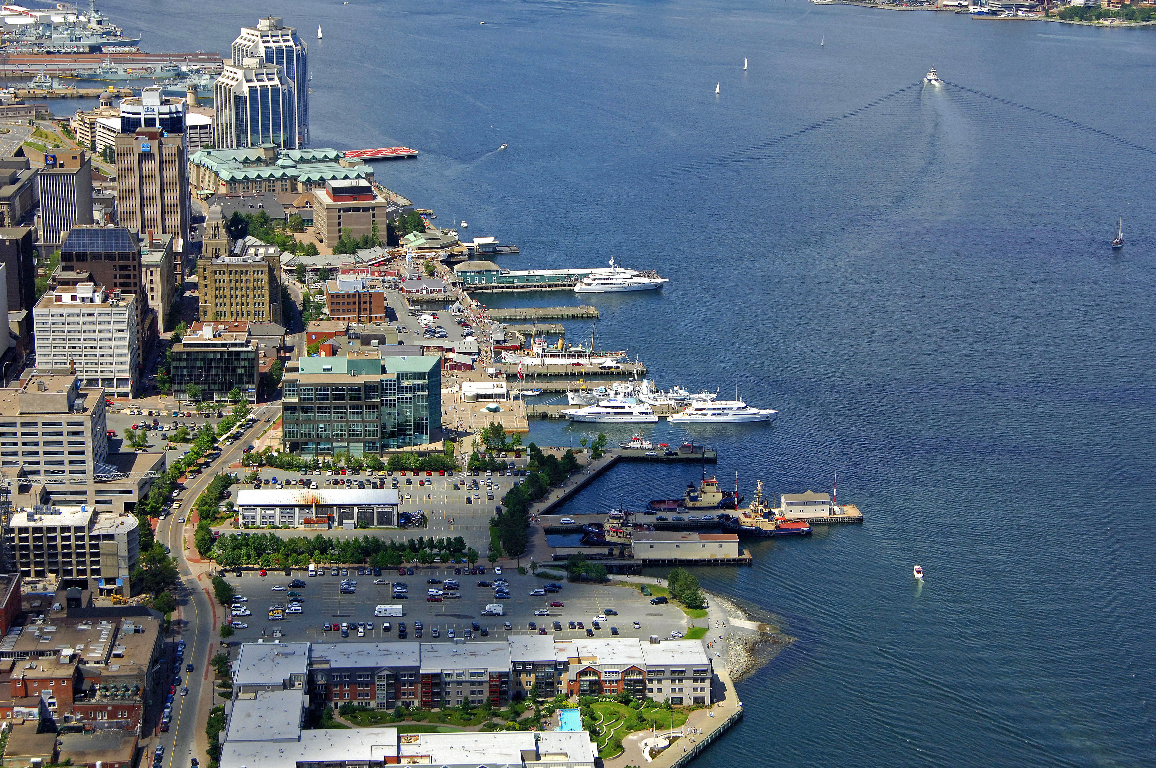
Clue #2
This city owes its existence largely to its location on one of the largest and deepest ice-free natural harbors in the world.

Slide 34
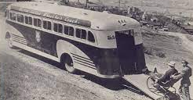
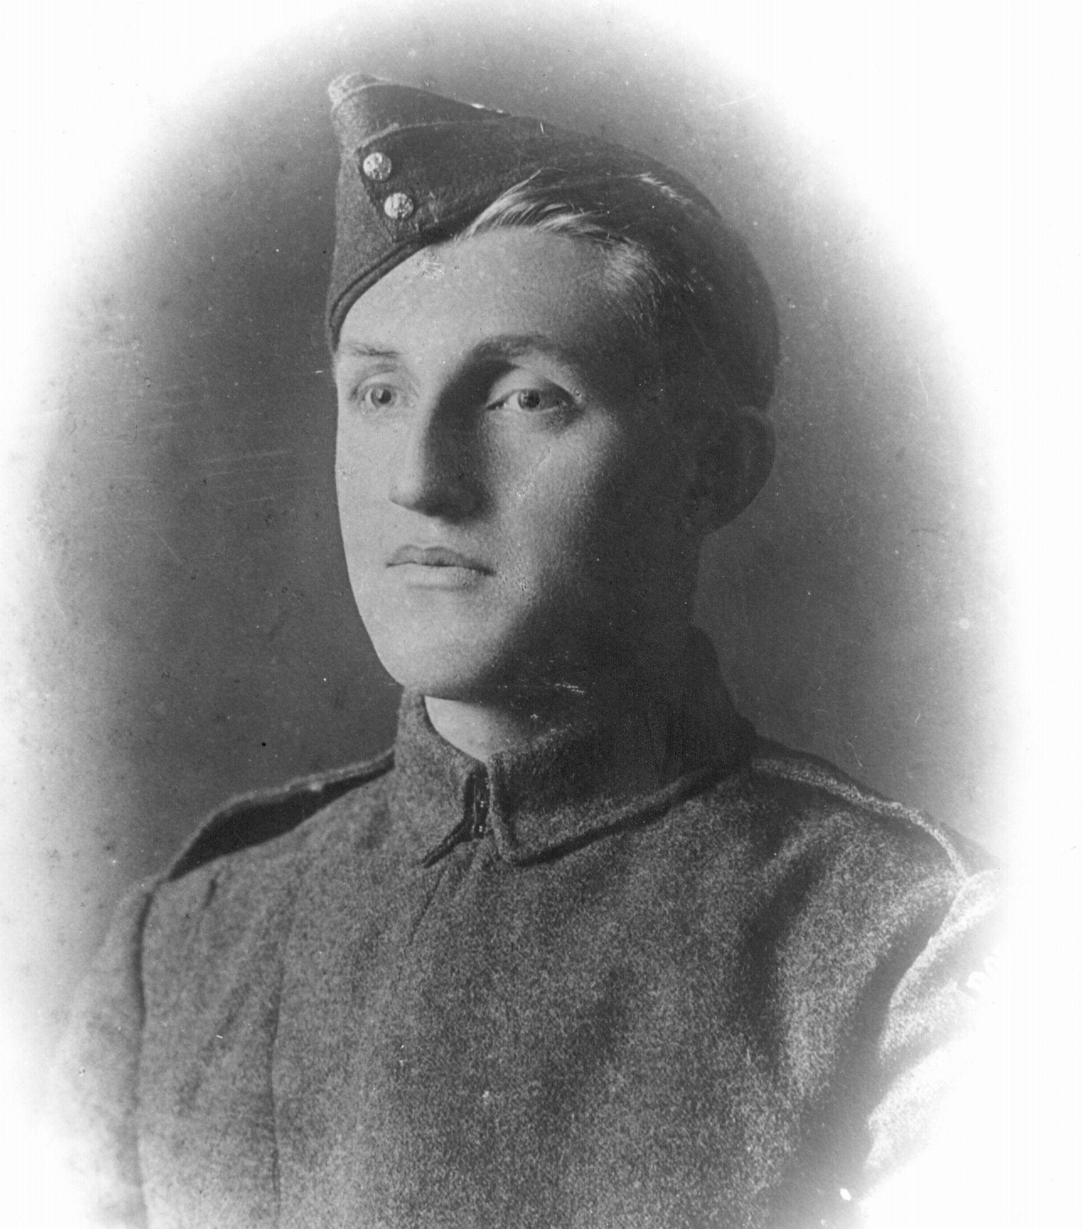
Clue #3
Walter Callow invented accessibility buses here, for veterans returning from WW2 and others in wheelchairs. Callow, a veteran, designed and managed the bus while he himself was blind and quadriplegic.
Walter Callow

Slide 35
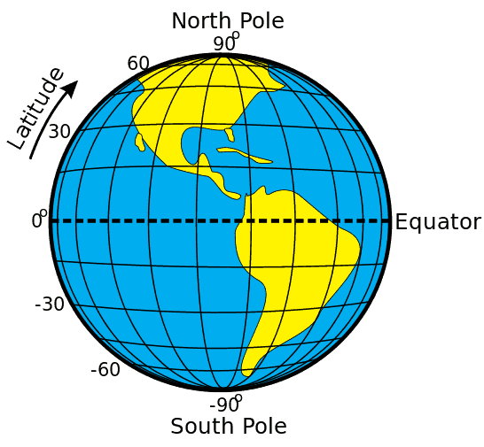
Clue #4
This city is located almost exactly halfway between the equator and North Pole!

Slide 36
Final Clue!
Actor Elliot Page
Singer-Songwriter
Sarah McLachlan

Slide 37
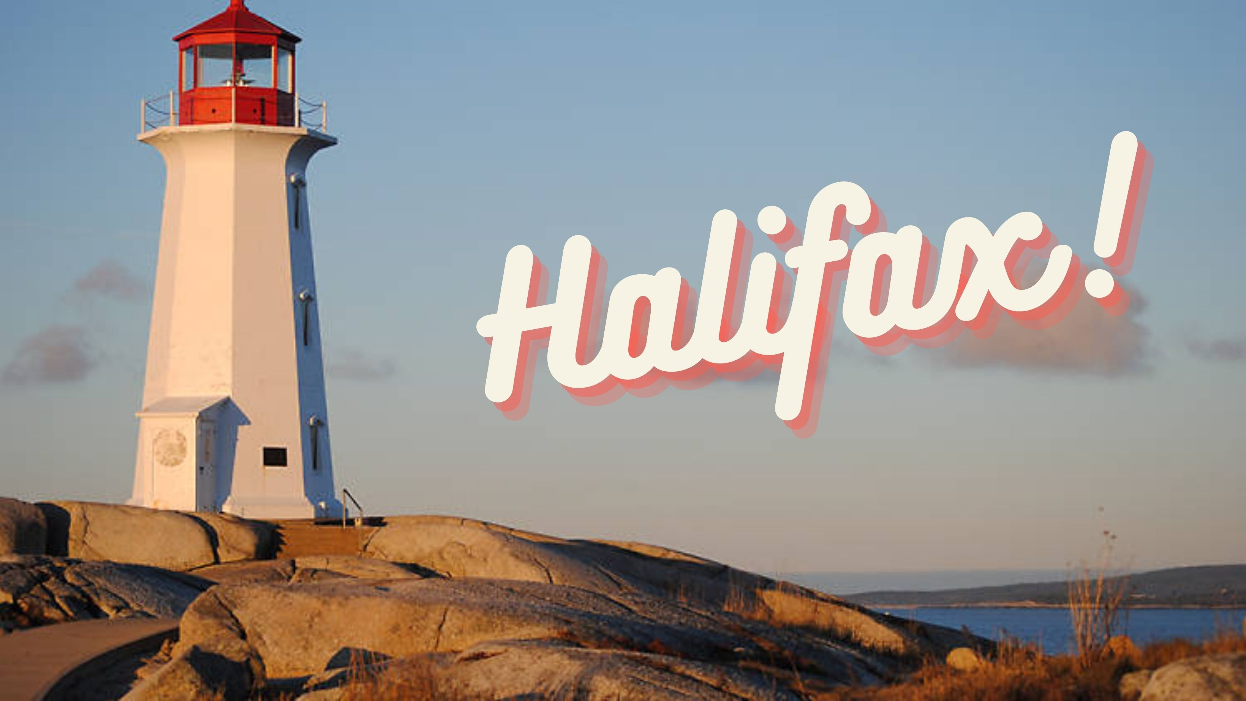
You’ve just visited:

Slide 38
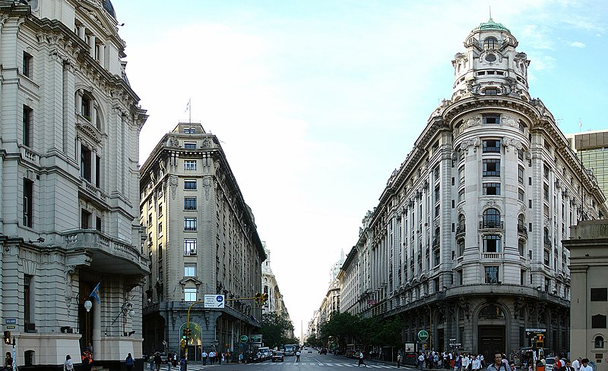
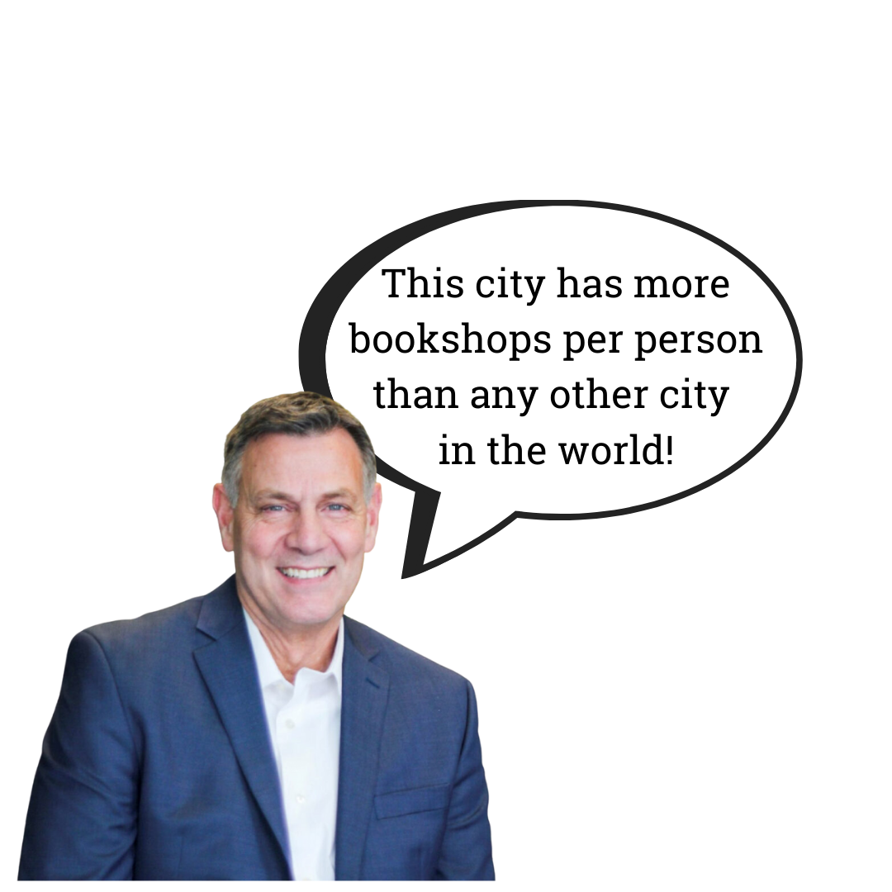
Location 7, Clue #1

Slide 39
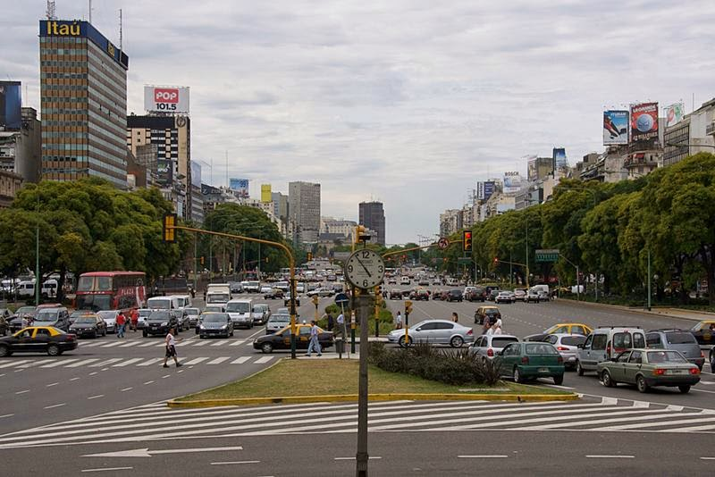
Clue #2
This city is home to the W I D E S T
street in the world!

Slide 40
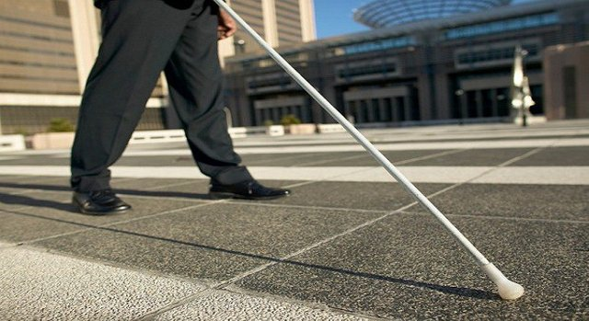
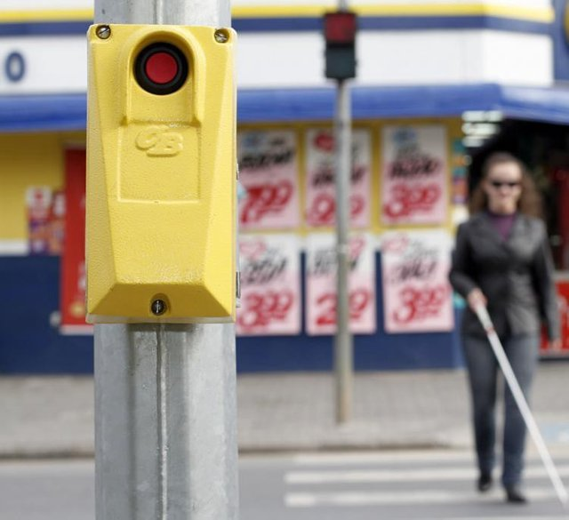
Clue #3
Two important accessibility tools were invented in this city. Traffic lights for the blind produce sounds at different speeds to indicate when it is (or isn’t) safe to cross the street. Canes for the blind are both a tool and symbol to alert others that the user may need help.

Slide 41
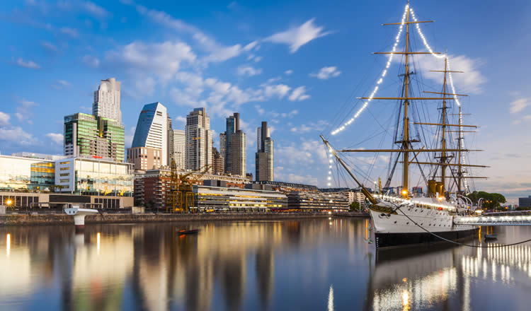
Clue #4
This city’s port is the largest on the continent!!

Slide 42
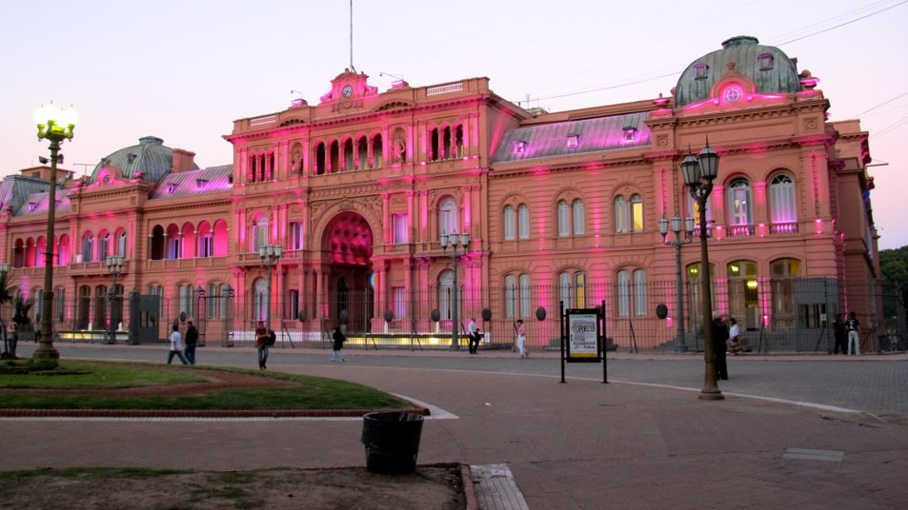
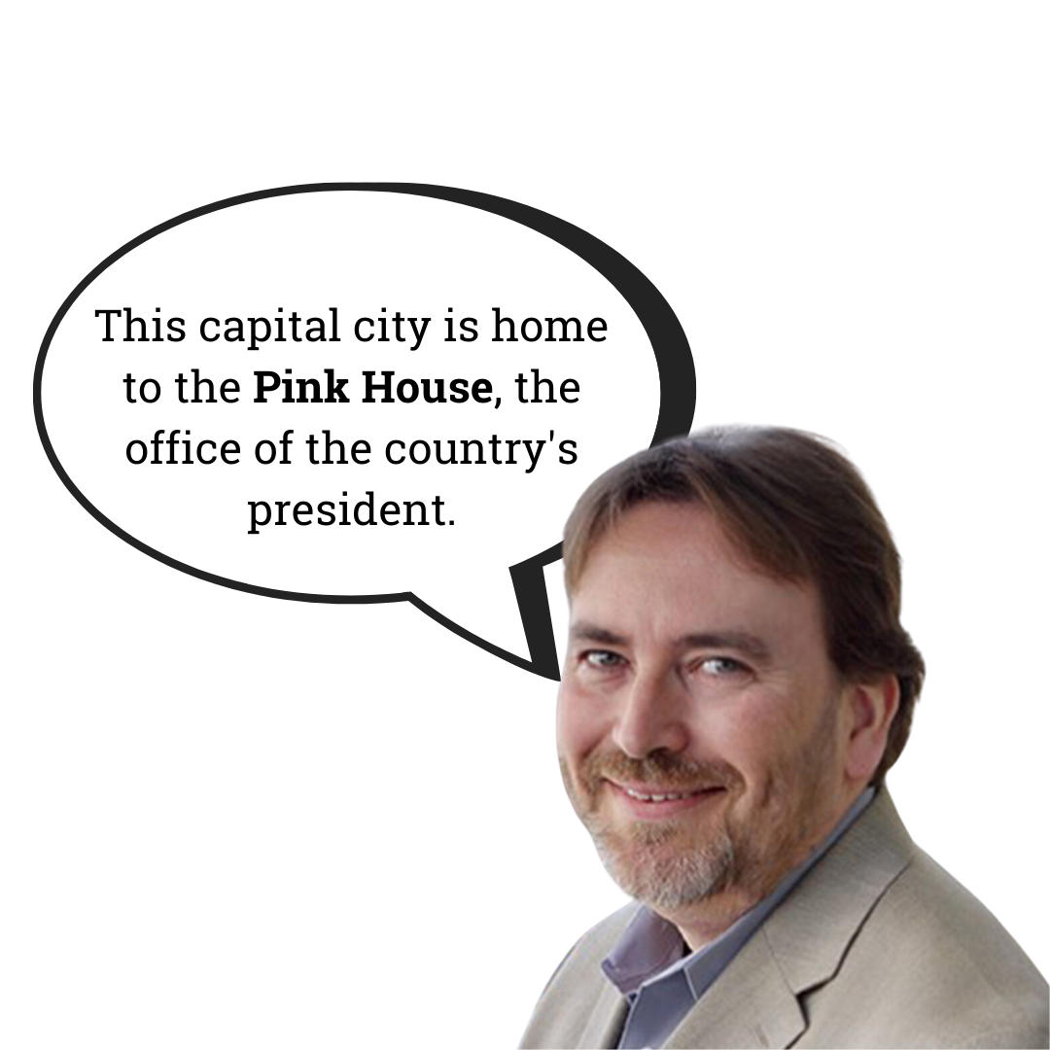
Final Clue!

Slide 43
You’ve just visited:

Slide 44
Location 8, Clue #1

Slide 45
Clue #2
This city is one of the most accessible in the world! Over 95% of bus shelters, taxi stands, and pedestrian walkways are barrier-free.

Slide 46
Clue #3
The infrared fever screening system was invented here! The system can detect heat emissions from the body and identify those with a fever. TIME Magazine named this one of the best inventions of 2003.

Slide 47
Clue #4

Slide 48
Final Clue!
Don’t worry about stepping in gum here! Chewing gum was outlawed in 1992. The first-time penalty for selling gum can be as high as $100,000 or up to two years behind bars.

Slide 49
You’ve just visited:

